Slide 1
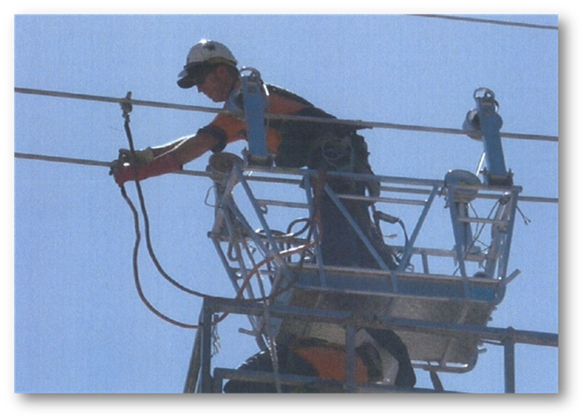
Lessons from the death of Danny Cheney
Notes:
On Saturday December 5th Danny Cheney, employed by John Holland as a construction manager, died as a result of receiving electric shocks from induced current while working on the Strathmore to Ross high voltage transmission line near Townsville, Queensland.
His colleague, Manquin Parungao, also employed by John Holland as a EWP operator also received minor burns from electric shocks and was hospitalised for 36 hours.
The work involved traversing a pair of conductors in a trolley to be suspended from the conductors to act as a mobile work platform to allow the installation of spacers between the conductors. The transmission line and the conductors were under construction and not energised at the time.
The primary cause of the incident was the failure to properly earth the conductors before commencing work on the line.
This was a tragic, senseless and needless death as the incident was totally preventable.
The photograph that you see here was taken just seconds before Danny Cheney received the fatal shocks
The purpose of this briefing today is to understand from the incident investigation findings what was the work involved, what went wrong, why it went wrong and how it could have been prevented - and to ask ourselves what would we need to do to prevent such a death of someone on our team

Slide 2
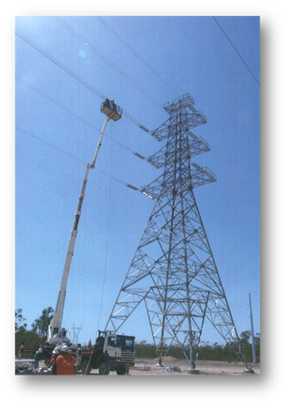
The job
The transmission line and conductors were under construction and not energised at the time
The work involved the installation of spacers between conductors on the transmission line.
This work is necessary to complete the construction of high voltage power lines
Access to do this work was planned via a mobile work trolley suspended from the conductors to allow the safe installation of the spacers
The mobile work trolley is typically installed by raising it and the workers via an elevated work platform (EWP)
Actual photograph of the work underway on December 5th 2009

Slide 3
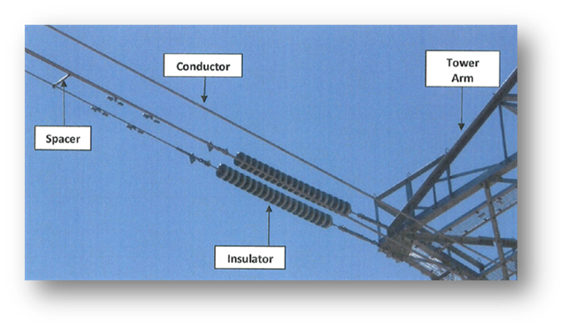
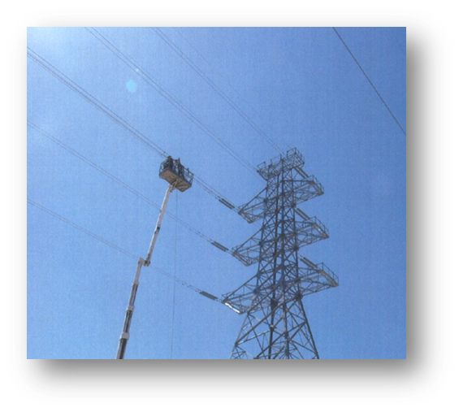
The risks
When a conductor (transmission line) is energised a magnetic field is generated around it. This magnetic field can induce a voltage in an adjacent non-energised conductor by:
Current levels in adjacent energised conductors in service
Close proximity to adjacent energised conductors
In this case the closest energised line was a 275 kV line approx 15m away
Working at height is a major risk involved in this activity
Photo of tower, conductors, insulators and spacers

Slide 4
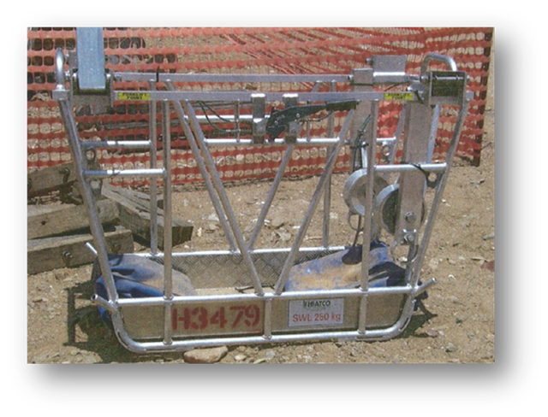
Risk management
The major risks involved in this work are well known and respected by all involved
Working at height risks are mitigated by suspending an elevated work trolley between the conductors
The risks of receiving an electric shock from induced voltage is mitigated by
earthing the conductors via both towers on each end of the conductors and
by de-energising adjacent conductors
A strict procedure exists to ensure that workers are protected from such risks
Photo of typical elevated work trolley and being hoisted into position via EWP

Slide 5
What should have happened
An Activity Method Statement (AMS) completed
A permit to work issued
A prestart meeting held with the work crew
The following requirements of the AMS complied with:
A Task Risk Assessment (TRA) completed before the activity to review any specific risks on the day and to manage change
Strict compliance with the working at height procedures
Strict compliance with procedures requiring earthing to the towers via earthing cables
Mandatory use of equipment such as a hot stick and PPE such as hot gloves
Photograph of Danny Cheney and Manquin Parungao in the EWP moments before the incident occurred

Slide 6
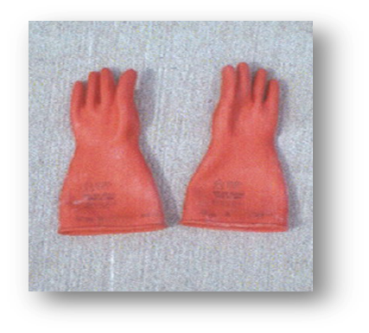
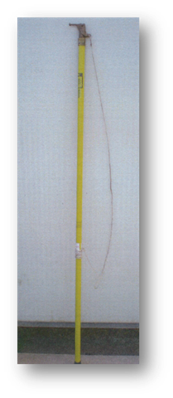
What actually happened - 1
An Activity Method Statement (AMS) was prepared, accepted and signed by all concerned including Danny Cheney two days before the incident.
A work permit for working at height activity was issued the day before the incident which required a Task Risk Assessment (TRA) to be completed - however the TRA was not carried out
On the day of the incident a mandatory prestart meeting was not held
The procedure requires that a hot stick and hot gloves be used to attach a earthing cable to a conductor, however there was no hot stick present on the job.
In the absence of a hot stick Danny got a pair of hot gloves from the boot of his car
Photograph of a typical hot stick and pair of hot gloves
A hot stick is an insulated telescopic device which allows remote attachment of a earthing cables head clamp to a conductor.
Hot gloves are rubber gloves used when working around High Voltage electricity.

Slide 7
What actually happened - 2
Work started – the AWS requirements were completely ignored
Instead of earthing the conductor to the towers Danny instructed Manquin Parungao to fix the earth clamp to the EWP.
Lacking a proper attachment point, Manquin attached the clamp to the lanyard attachment point in the EWP basket.
Danny attached the head clamps of the earth cable to each of the conductors, wearing a hot glove on his left hand and a riggers glove on his right hand (see photo)
Photograph of Danny connecting the earthing leads to the EWP seconds before receiving a fatal shock – not the hot glove on his left hand and riggers glove on his right.
Notice also his rolled up sleeves

Slide 8
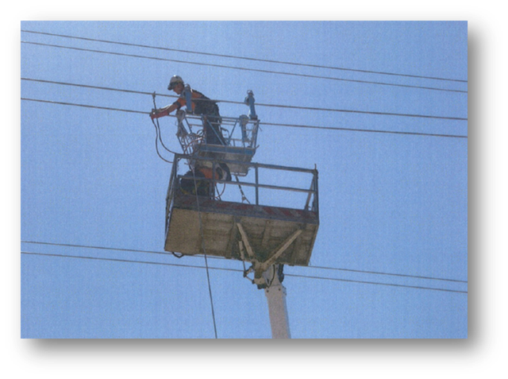
What actually happened - 3
Manquin asked Danny whether he should remove the earth and got no answer.
Manquin looked up to see Danny Cheney undoing one of the clamps.
Manquin put a hot glove on his right hand and heard a buzzing sound. He looked up and saw Danny jump back.
He himself then received 4 separate shocks.
Photograph of Danny and Manquin earthing the conductors on the EWP

Slide 9
Outcome
The death of Danny Chaney and a serious injury to Manquin Parungao

Slide 10
The unanswered question
Why did a highly experienced, trained person who was heavily involved in the planning of the job and with all the authority to make decisions regarding the job, make a conscious decision not to comply with well established rules and procedures to undertake this job safely?

Slide 11
So what caused this fatality?
The fatal incident was thoroughly investigated by John Holland. The finding of this investigation identified the following causes:
Primary Cause
Failure to earth the conductors in accordance with the Activity Method Statement
Contributory factors – system and equipment
Failure to carry out pre start briefing with work crew
Failure to develop a Task Risk Assessment in accordance with the AMS and Work Permit
Failure to use a hot stick to attach head clamp to conductors
Failure to wear hot gloves when required

Slide 12
So what caused this fatality?
Contributory factors – the human factors
Failure to adequately manage change i.e. failure to ‘stop the job’ when changes occurred to reassess the risks. Changes were:
absence of regular operator causing supervisor to step in to do the work
Hot stick not available at work site
Failure of 3 people who were watching Cheney and failed to speak up and stop the job – including his colleague Manquin
Ultimately, lack of appropriate equipment forced those involved to make inappropriate decisions

Slide 13
So what caused this fatality?
Contributory factors – organisational
Failure of supervision – Cheney was the Construction Manager, but was actually heavily involved in doing the job himself
Custom and practice – there was a suggestion that there was some common industry practice regarding ‘short cuts’ in earthing procedures
Conclusion of the Investigation Report
“There is no doubt that the crew involved in the incident...were all properly informed of and aware of the risks of induction shocks and were unambiguously instructed in the correct approach to earthing.”

Slide 14
Questions for supervisors and managers:
Do you personally comply with all rules and procedures at all times? If you don’t comply, how can you expect others to do so?
Do you actively encourage people to raise safety issues with you, including issue relating to your own behaviour?
How do you ensure that work is properly planned and resources provided so as to minimise the risk that work crews are placed in a position to make a “crunch” decision at the worksite i.e. “Do we delay the job to get the proper equipment/resources or just go ahead with the additional risk”?

Slide 15
Questions for supervisors and managers:
What is your role in ensuring that experienced, trained people, comply with the rules and procedures to undertake their work?
How do you (and will you) verify that people are complying? How do you know if people are complying or not?
Are you aware (and/or do you have a feeling) that persons and/or common practices exist where people/crews are not fully complying with safety rules and procedures?
If so, what or who is getting in the way of you acting to correct this situation?
What do you need to do to ensure people are actively using the systems and tools your organisation has in place today?

Slide 16
Questions for the work crew
Why would experienced, trained people such as yourselves, be tempted not to comply with well established rules and procedures to undertake this job?
What does, or would get, in the way of you following the safety rules?
How will we overcome these temptations?
What gets in the way of us intervening when we see someone acting as they should not?
What do we need to do as a crew to encourage our mates to intervene when they see an unsafe act?

Slide 17
Learning for all work crews
We must comply with the rules and procedures within the health & safety management system at all times:
pre-start meetings and risk assessments are essential, and must be carried out before any work can begin.
proper equipment must be used at all times
We must speak up and intervene when you see someone not following the rules. This needs to include when:
you are unsure whether the act is ‘right’ or ‘wrong’ – but does not feel right
the person is a Manager, Supervisor, or more experienced than you
You don’t have to have a specific title or answer – being unsure is enough for you to speak up. Walking by is not an option.

Slide 18
Learning for all work crews
We must ask questions when you are unsure about the task, about how the crew will control hazards, and how we will comply with all rules and procedures
We need to be mindful and aware at all times of potential hazards. We must never get complacent and think “...it can’t happen to me”

Slide 19
Questions or comments?

